Slide 1
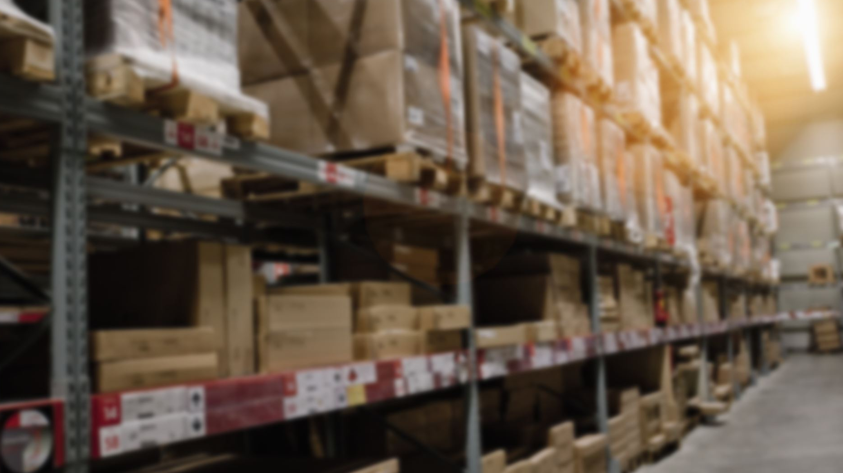
STREAMLINE LOGISTICS
PRESENTATION BY
ADE ADEYEMI
Optimizing Order Fulfillment: A Data-Driven Approach to Eliminate Backlogs

Slide 2

BUSINESS INTRODUCTION
Streamline Logistics Solutions is a distinguished and
long-standing player in the supply chain and logistics industry,
with a rich history dating back over two decades.
They have built their reputation on a commitment to delivering
exceptional service, characterized by the swift and dependable
delivery of a wide array of products to customers nationwide.
This company stands as a pillar of reliability, ensuring that
businesses and consumers alike can count on them to transport
their goods efficiently and with care.
However, even as they continue to flourish, They find
themselves facing a pressing operational challenge that
demands innovative solutions to uphold an
unwavering commitment to service excellence.

Slide 3

PROJECT FOR DATA SETS
● Order ID: A unique identifier for each customer order.
● Delivery Address: The address to which the order is to
be delivered.
● Order Timestamp: The date and time when the order
was placed (e.g., "2023-09-01 08:00").
● Order Status: The status of the order (e.g., "In
Progress" or "Completed").
● Driver ID: A unique identifier for each driver assigned
to deliver orders.
● Vehicle Info: Information about the delivery vehicle
used for the order.
● Current Location: The current location of the delivery
driver during order delivery.
● Delivery Time: The total time taken for delivery,
measured in minutes (e.g., "120 min").
● Delays: Any delays that occurred during the delivery,
measured in minutes (e.g., "15 min").
● Customer Feedback: Feedback from the customer
regarding the delivery experience (e.g., "Positive" or
"Negative").
● Route: The specific route taken by the delivery driver
for the order.
● Delivery Zone: The geographic zone or area the
delivery is made.
● Allocation Rules: Rules used to allocate resources for
the delivery (e.g., "Standard Rules" or "Expedited
Rules").
● Timestamp for Tracking: The date and time of tracking
data points (e.g., "2023-09-01 08:15").

Slide 4
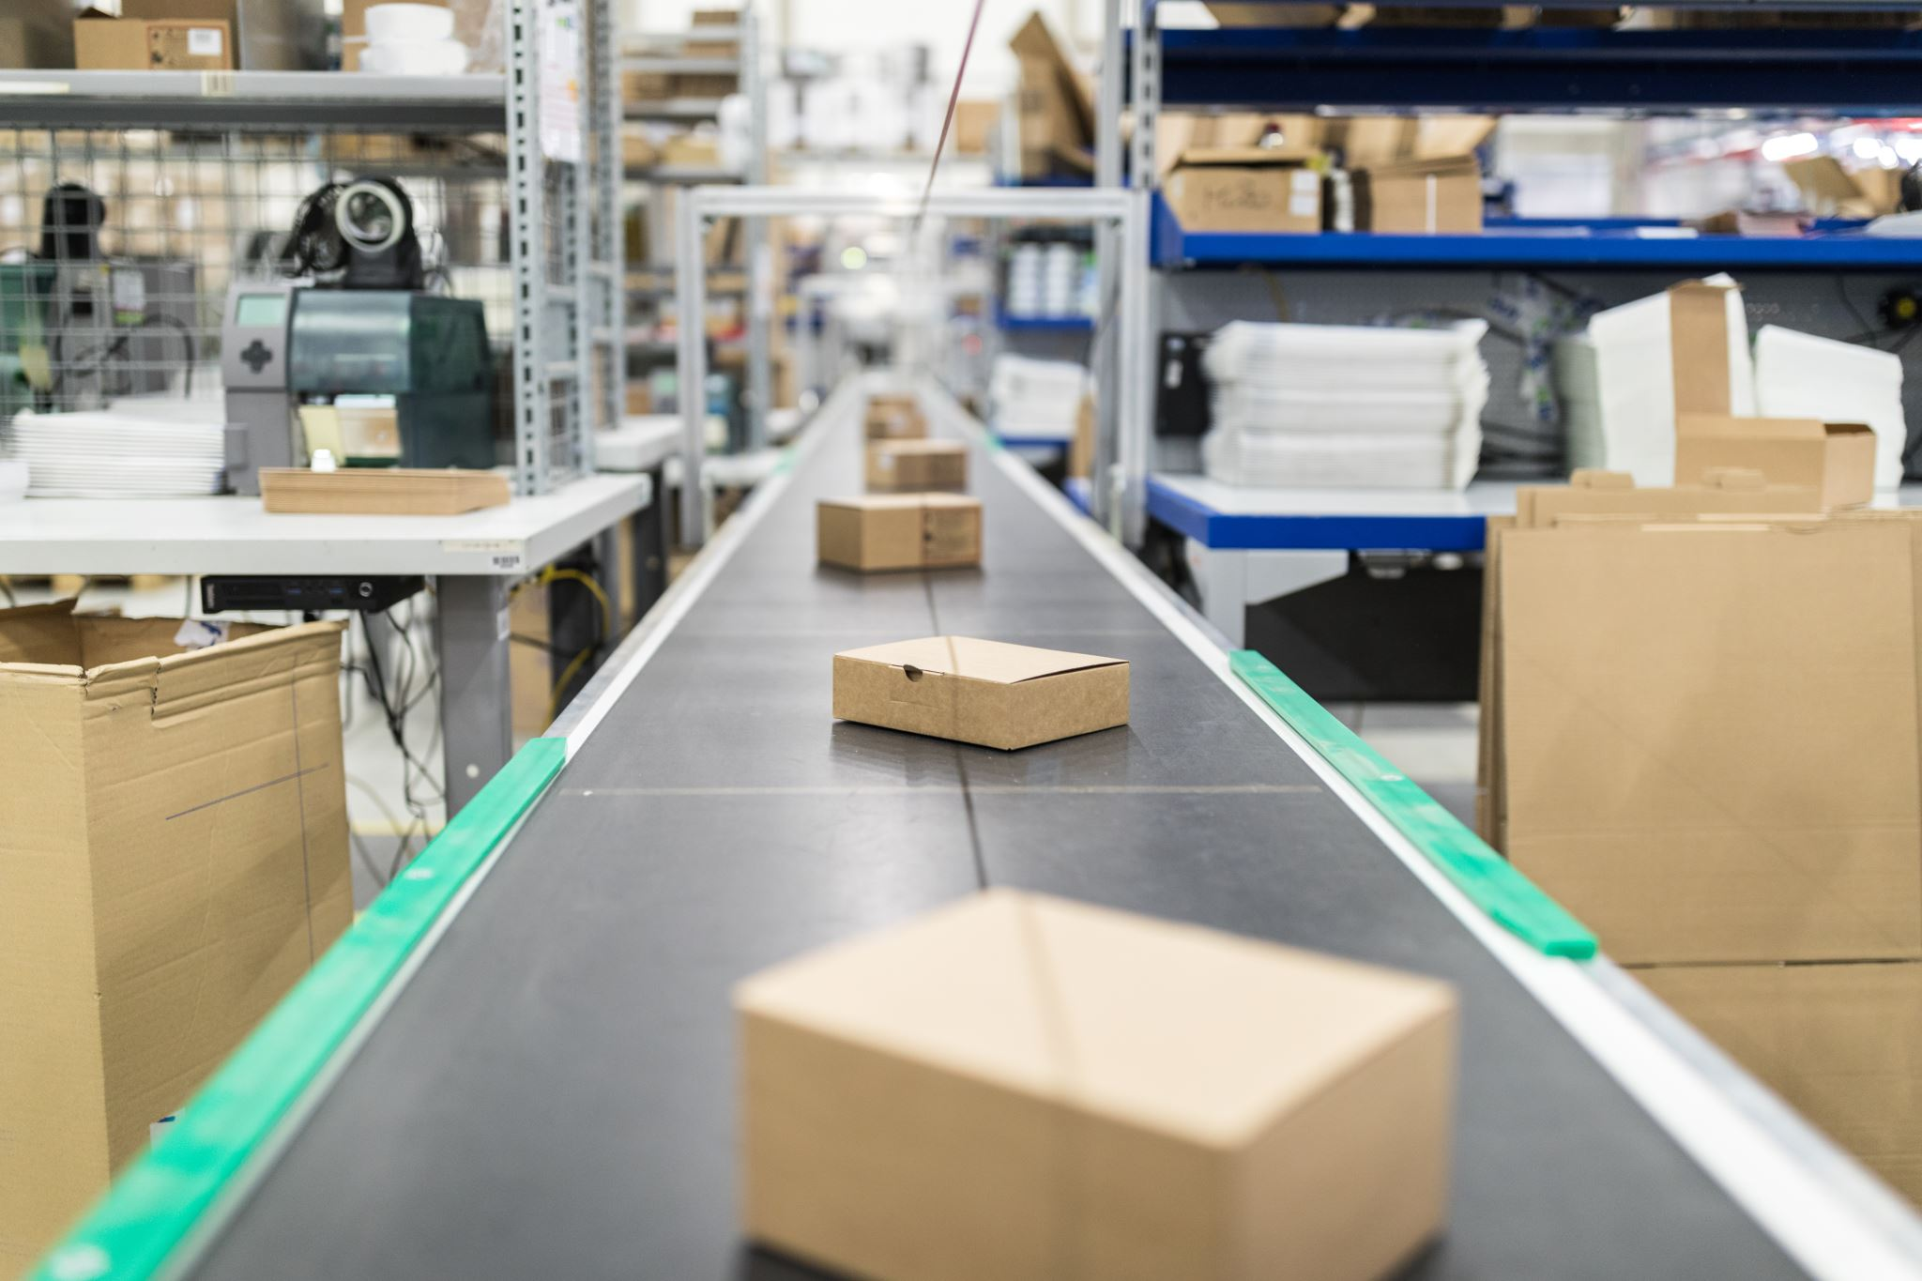
BUSINESS PROBLEM
At Streamline Logistics Solutions, They encounter several pressing challenges within our order fulfilment process:
Mounting Order Backlogs
Visibility Gap
Customer Frustration
Escalating Costs
Customer Satisfaction
Operational Efficiency
Data-Driven Insights
Reputation Management
RATIONALE FOR PROJECT

Slide 5

AIM OF PROJECT
On this project, developing an interactive dashboard that provides more visibility into our order fulfilment processes, the aim is to:
Efficiently allocate delivery resources based on order volume and location.
Monitor order progress and proactively identify potential
delays.
Enhance customer communication with timely delivery status updates.
Reduce order backlogs and operational costs.
Elevate overall customer satisfaction and safeguard
reputation as an industry leader.

Slide 6
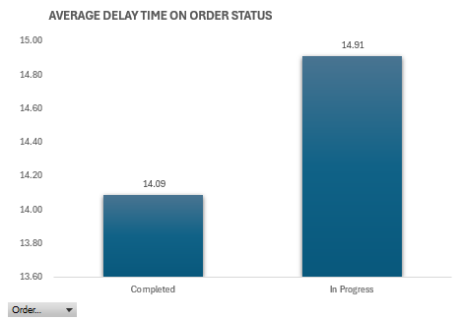
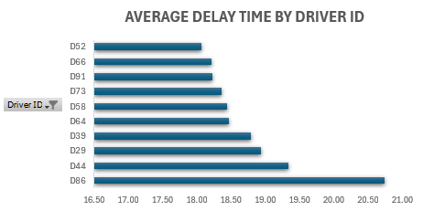
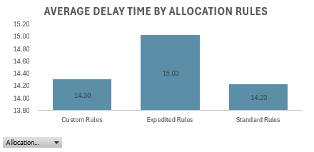
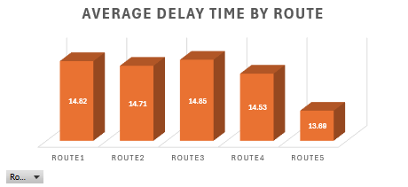
DEEP ANALYSIS 1

Slide 7
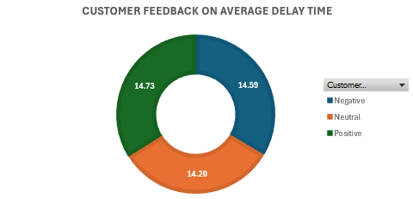
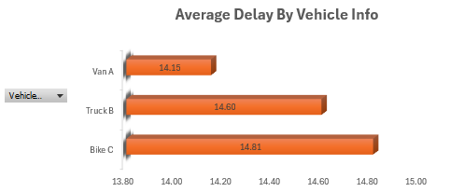
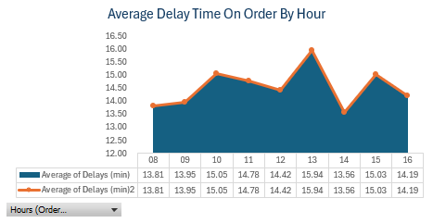
DEEP DIVE ANALYSIS 2

Slide 8
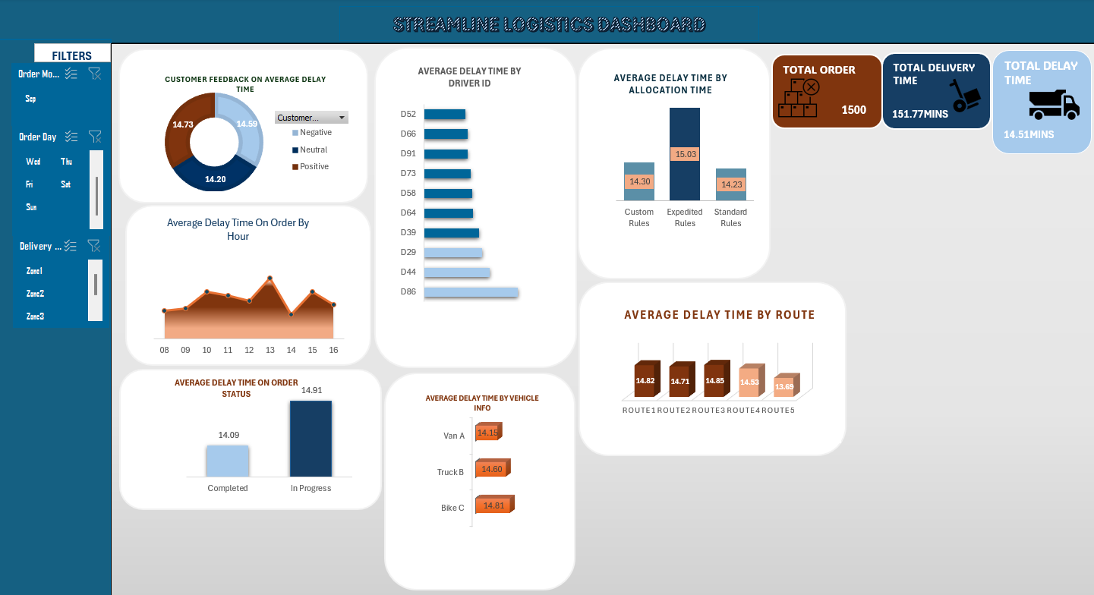

Slide 9

KPI SUMMARY
DELAY IMPACT
Resource Allocation Efficiency
Order Completion
49%
Average Delivery Time
151.77 Mins
Driver/Zone (Zone 1)
100
99
% of Delayed Orders
97%
Customer satisfaction score
32%
Driver Zone (Zone 2)
Backlog Rate
51%
Average Delay Time/order
14.51 Mins
Driver Zone (Zone 3)
99

Slide 10
INSIGHTS
Through order backlog It is evident that the total delivery in total as the total delivery is 1500 and the delivery in progress which hasn't been completed is 767,This is an issue that needs to be addressed as a continuation of this can possibly lead to bad reviews being left by customers.
From the deep dive analysis completed it can be observed that there is a total delay time of 14.51 for delivery which I feel is a bit moderate, but I think we can still do better on that area by possibly checking with the drivers to see if there was something else that they felt might be causing a delay time for delivery for example maybe when a certain route is being used.
Customer Feedback on delay time has more positive feedback on delay time than the negative feedback which does mean that delay is not the overall issue of this logistic backlog as there might be other reason which we should explore further on this insights.
Average delay time by drivers is a bit concerning as we need to look into this to understand is there a reason why they are having much of this delay as maybe to know if it's due to route or vehicle type and to see if there are any issue that might be impacting their performances with delivering promptly and also maybe re-training drivers on prompt delivery and with it entails, Route recommendation and maybe check to see if vehicle maintenance could be beneficial.
Route delays, Take from example from our deep five analysis Route 1,2 and 3 are the route with most average time delay that is a bit concerning and should be investigated to see if there is a reason why there might be delay on that route for example due to congested traffic and see if we can consider a route diversion to see if that helps.
Vehicle type and delay ,it is a bit concerning that the Bikes C has the highest delay, which is worth it if we can get to understand why the bikes have the highest delay, it is also worth checking to know are the Bike C drivers under trained ,if that is the case they could undergo go fresh training and be prioritise to have more frequent training on swift delivery and also to check for the Bike C need more attention and regular maintenance and check if the weight of goods they supply impact their ability to arrive in time.
Allocation rules, from the deep analysis Expedited Rules has the most delay time which wasn't meant to be the case as customers who request for the expedited delivery do so as they want their goods delivered to them as quickly as possible, It might be beneficial if we are able to prioritise expedited deliveries and monitor them closely by setting aside drivers or vehicle types which are our fastest to handle such rules so that we are able to meet up with the purpose why the customer requested for such deliveries in the first place.

Slide 11
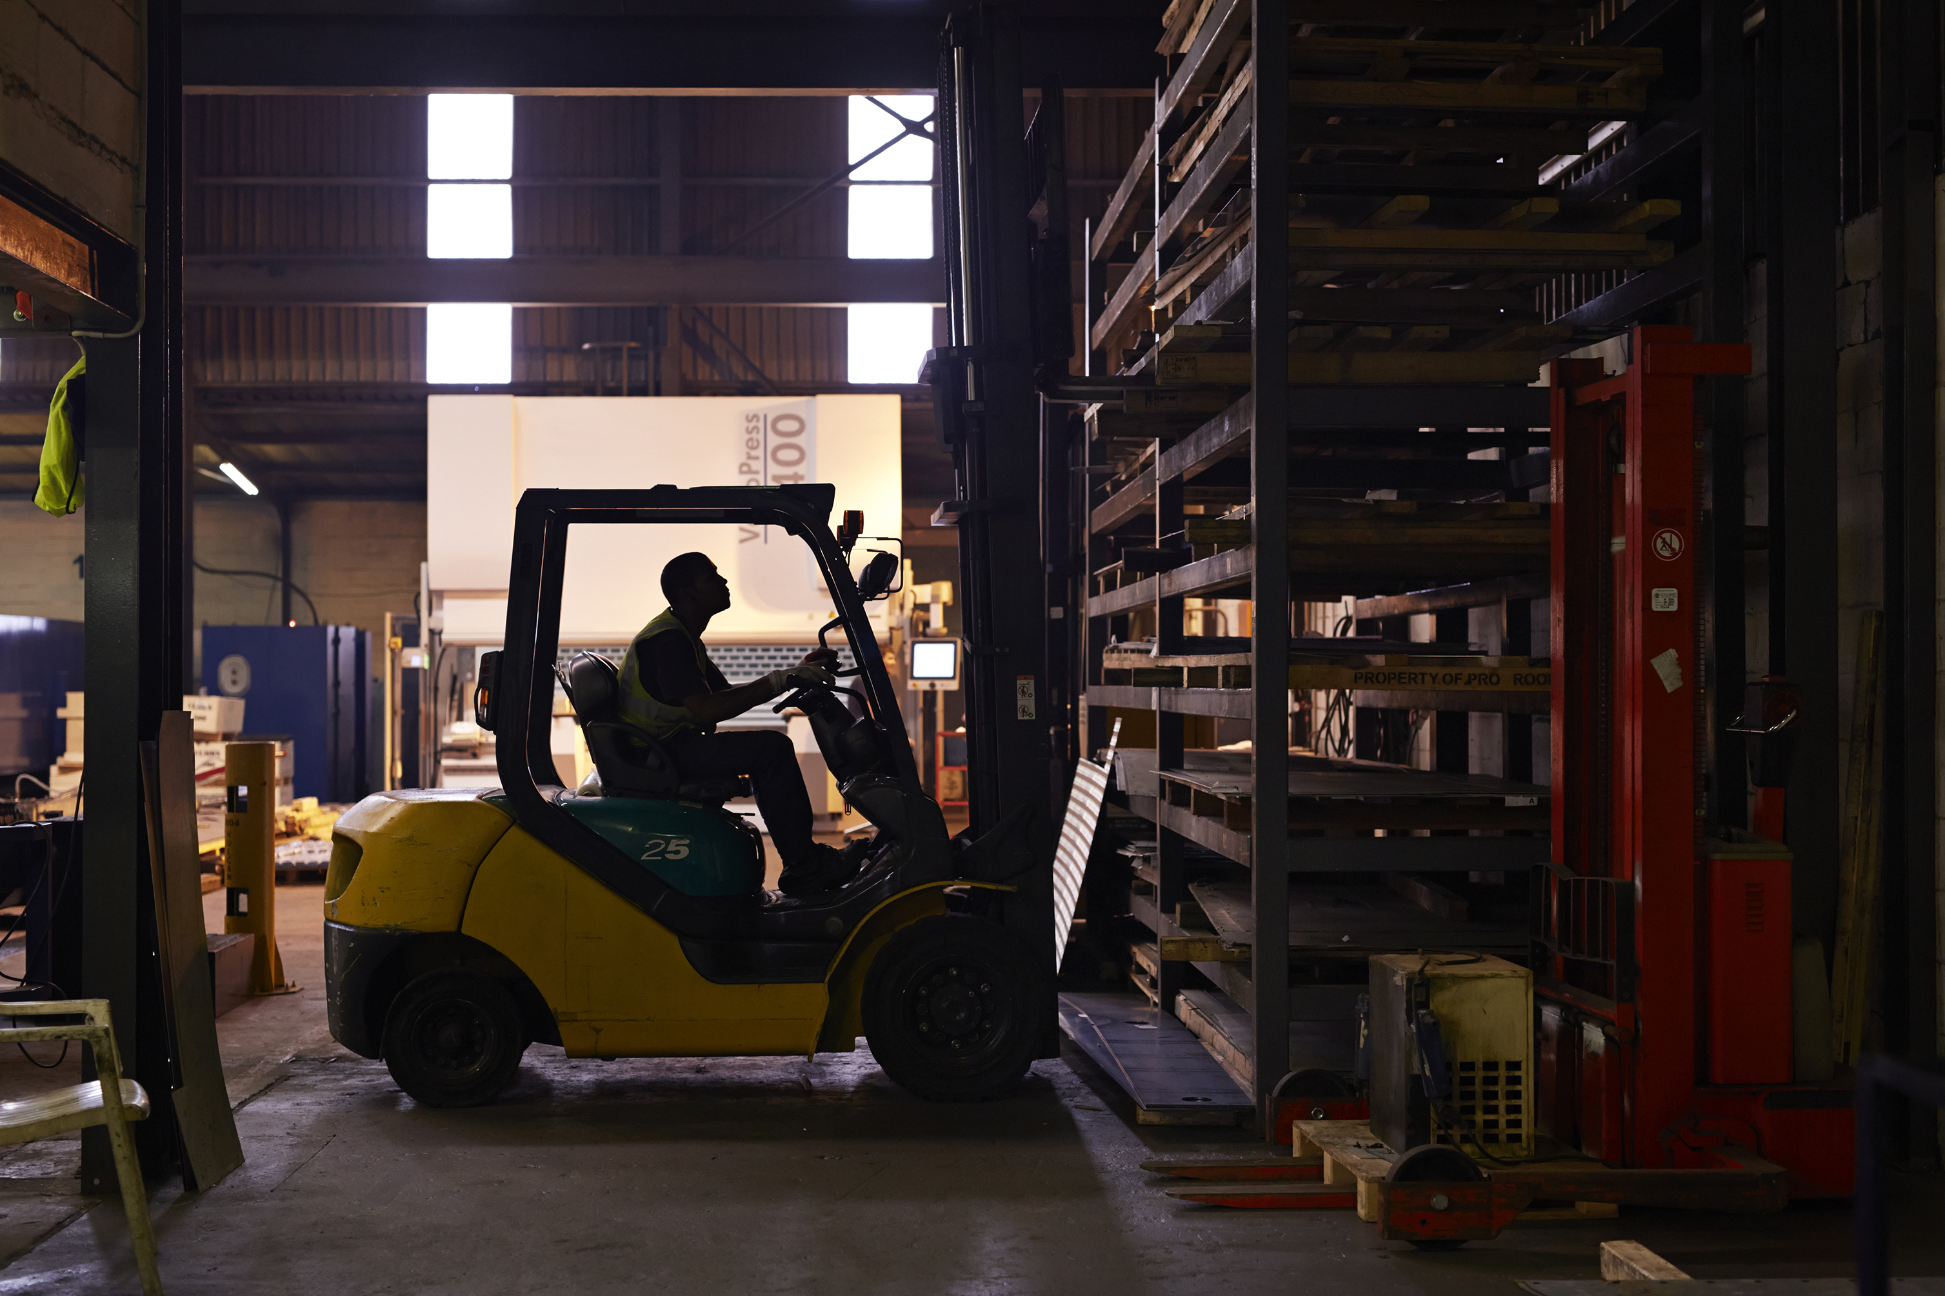
RECOMMENDATIONS
1.It will be helpful if we can take stock of the backlogs we have and prioritise them first and see if that we help clear some few backlogs we have
2. Checking with the drivers to see if there was something else that they felt might be causing a delay time for delivery for example maybe when a certain route is being used.
3.Re-training drivers on prompt delivery and with it entails, Route recommendation and maybe check to see if vehicle maintenance could be beneficial and, we could introduce bonuses or rewards for fastest delivery drivers who meet up to expectations with quick delivery timeframe to keep them motivated.
4.Consider a Route diversion by first setting a group to inspect route again and then checking for alternative route to that route.
5.Have more frequent training on swift delivery, the Bike C need more attention and regular maintenance and check if the weight of goods they supply impact their ability to arrive in time.
6. Prioritising expedited deliveries and monitor them closely by setting aside drivers or vehicle types which are the fastest to handle such rules so that we can meet up with the purpose why the customer requested for such deliveries in the first place.

Slide 12

THANKS FOR LISTENING

